Slide 1






Workshop UAustral: Práctico 1
Ensamble de genomas, anotación y búsqueda de homólogos
Dr. Jonathan Maldonado
Researcherid J-6429-2012
jomaldon@gmail.com
jomaldon
@JM_bioinfo

Slide 2


Slide 4


Slide 5
Tipos de archivos que usaremos
FASTA
FASTQ

Slide 6
Archivos FASTA
cat SRR1811524_1M.fasta | head -n 12
>SRR1811524.2 HWI-ST615:645:H7P8JADXX:1:1101:1414:2351/1
CTTAGCTTGTCGAAACAACATCCAAGAGTTCATGCTTAACCAACTCGGAAT
>SRR1811524.3 HWI-ST615:645:H7P8JADXX:1:1101:1416:2377/1
CCGACTTGTTCTGCGTATCTAGACTAACTCTGGTTTCCCTCTTAGACAAAG
>SRR1811524.4 HWI-ST615:645:H7P8JADXX:1:1101:1479:2437/1
CAAACACTTTCCAGGATACCACTCAATCTCCGTCCCGAGGGCCTTCTCAAG
cat SRR1811524_1M.qual | head -n 12
>SRR1811524.2 HWI-ST615:645:H7P8JADXX:1:1101:1414:2351/1
5 10 15 20 30 40 40 40 40 40 40 40 40 40 40 40 40 40 40 404 04 04 040 40 40 40 40 40 40 30 20 10 5
>SRR1811524.3 HWI-ST615:645:H7P8JADXX:1:1101:1416:2377/1
5 10 15 20 30 40 40 40 40 40 40 40 40 40 40 40 40 40 40 404 04 04 040 40 40 40 40 40 40 30 20 10 5
>SRR1811524.4 HWI-ST615:645:H7P8JADXX:1:1101:1479:2437/1
5 10 15 20 30 40 40 40 40 40 40 40 40 40 40 40 40 40 40 404 04 04 040 40 40 40 40 40 40 30 20 10 5

Slide 7
Archivos FASTA
cat SRR1811524_1M.fasta | head -n 12
>SRR1811524.2 HWI-ST615:645:H7P8JADXX:1:1101:1414:2351/1
CTTAGCTTGTCGAAACAACATCCAAGAGTTCATGCTTAACCAACTCGGAAT
>SRR1811524.3 HWI-ST615:645:H7P8JADXX:1:1101:1416:2377/1
CCGACTTGTTCTGCGTATCTAGACTAACTCTGGTTTCCCTCTTAGACAAAG
>SRR1811524.4 HWI-ST615:645:H7P8JADXX:1:1101:1479:2437/1
CAAACACTTTCCAGGATACCACTCAATCTCCGTCCCGAGGGCCTTCTCAAG
identificador
secuencia
cat SRR1811524_1M.qual | head -n 12
>SRR1811524.2 HWI-ST615:645:H7P8JADXX:1:1101:1414:2351/1
5 10 15 20 30 40 40 40 40 40 40 40 40 40 40 40 40 40 40 404 04 04 040 40 40 40 40 40 40 30 20 10 5
>SRR1811524.3 HWI-ST615:645:H7P8JADXX:1:1101:1416:2377/1
5 10 15 20 30 40 40 40 40 40 40 40 40 40 40 40 40 40 40 404 04 04 040 40 40 40 40 40 40 30 20 10 5
>SRR1811524.4 HWI-ST615:645:H7P8JADXX:1:1101:1479:2437/1
5 10 15 20 30 40 40 40 40 40 40 40 40 40 40 40 40 40 40 404 04 04 040 40 40 40 40 40 40 30 20 10 5
identificador
calidad

Slide 8
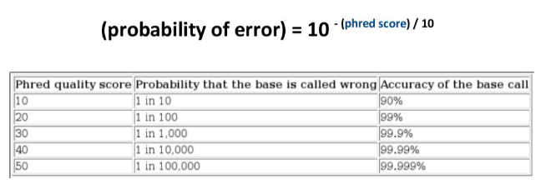
cat SRR1811524_1M.qual | head -n 12
>SRR1811524.2 HWI-ST615:645:H7P8JADXX:1:1101:1414:2351/1
5 10 15 20 30 40 40 40 40 40 40 40 40 40 40 40 40 40 40 404 04 04 040 40 40 40 40 40 40 30 20 10 5
>SRR1811524.3 HWI-ST615:645:H7P8JADXX:1:1101:1416:2377/1
5 10 15 20 30 40 40 40 40 40 40 40 40 40 40 40 40 40 40 404 04 04 040 40 40 40 40 40 40 30 20 10 5
>SRR1811524.4 HWI-ST615:645:H7P8JADXX:1:1101:1479:2437/1
5 10 15 20 30 40 40 40 40 40 40 40 40 40 40 40 40 40 40 404 04 04 040 40 40 40 40 40 40 30 20 10 5
identificador
calidad
Codificación
!"#$%&'()*+,-./0123456789:;<=>?@ABCDEFGHIJKLMNOPQRSTUVWXYZ[\]^_`abcdefghijklmnopqrstuvwxyz{|}~
0 1 2 3 .. 93

Slide 9
Archivos FASTQ
zcat SRR1811524_1M.fastq.gz | head -n 12
@SRR1811524.1 HWI-ST615:645:H7P8JADXX:1:1101:1015:2373/1
NAACACTCAACTTGAACGCAATGAACCAGGCACCAAACCCATGGCACGTGT
+
#4BDFFFFHHHHHIJJJJJJJJJJJJJIJJJJJIJJHIJJIJJIIGIJJAH
@SRR1811524.2 HWI-ST615:645:H7P8JADXX:1:1101:1414:2351/1
CTTAGCTTGTCGAAACAACATCCAAGAGTTCATGCTTAACCAACTCGGAAT
+
CCCFFFFFHFHHAHHIIIIEHIGIIHIIIIGEEIIIIEGGIGHIEFHGIIG
@SRR1811524.3 HWI-ST615:645:H7P8JADXX:1:1101:1416:2377/1
CCGACTTGTTCTGCGTATCTAGACTAACTCTGGTTTCCCTCTTAGACAAAG
+
@??DD?DDHFDF?GEEHIIJJEHEHIIAFHFHCGGGCBF@HGI@?FBDGED
...

Slide 10
Archivos FASTQ
zcat SRR1811524_1M.fastq.gz | head -n 12
@SRR1811524.1 HWI-ST615:645:H7P8JADXX:1:1101:1015:2373/1
NAACACTCAACTTGAACGCAATGAACCAGGCACCAAACCCATGGCACGTGT
+
#4BDFFFFHHHHHIJJJJJJJJJJJJJIJJJJJIJJHIJJIJJIIGIJJAH
@SRR1811524.2 HWI-ST615:645:H7P8JADXX:1:1101:1414:2351/1
CTTAGCTTGTCGAAACAACATCCAAGAGTTCATGCTTAACCAACTCGGAAT
+
CCCFFFFFHFHHAHHIIIIEHIGIIHIIIIGEEIIIIEGGIGHIEFHGIIG
@SRR1811524.3 HWI-ST615:645:H7P8JADXX:1:1101:1416:2377/1
CCGACTTGTTCTGCGTATCTAGACTAACTCTGGTTTCCCTCTTAGACAAAG
+
@??DD?DDHFDF?GEEHIIJJEHEHIIAFHFHCGGGCBF@HGI@?FBDGED
...
identificador
secuencia
separador
calidad

Slide 11
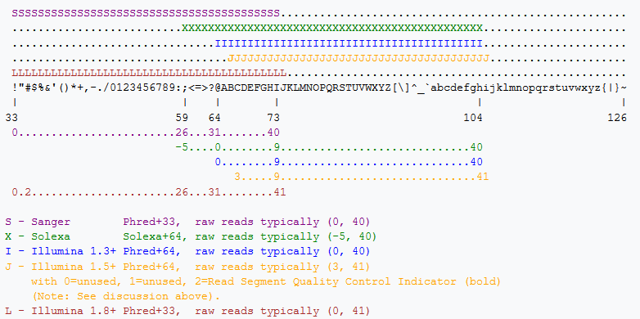
Codificación de calidad
https://en.wikipedia.org/wiki/FASTQ_format

Slide 12
E.Coli
https://www.biostars.org/p/160377/
https://www.ebi.ac.uk/ena/data/view/ERX008638
ftp://ftp.sra.ebi.ac.uk/vol1/fastq/ERR022/ERR022075/
Microbacterium sp. CGR2
https://www.ncbi.nlm.nih.gov/genome/14190?genome_assembly_id=410147
ABRPI-Training
https://sepsis-omics.github.io/tutorials/modules/data-dna/

Slide 13
The data
The read set for today is from an imaginary Staphylococcus aureus bacterium with a miniature genome. The whole genome shotgun method used to sequence our mutant strain read set was produced on an Illumina DNA sequencing instrument.
The files we need for assembly are the mutant_R1.fastq and mutant_R2.fastq.
(We don’t need the reference genome sequences for this tutorial).
The reads are paired-end.
Each read is 150 bases long.
The number of bases sequenced is equivalent to 19x the genome sequence of the wildtype strain. (Read coverage 19x - rather low!).

Slide 15
FIN

